Slide 1

How news appears on socıal medıa
Ekın Ocal

Slide 2
What Was My Purpose?
In this presentation, I try to present a Social Media Analysis using ‘How news appears on social media’ Datasets on kaggle. The datasets commonly contain Social Media Datas and sentiments in different subjects. I tried to use all of them in different ways. I hope iy will be helpfull content.

Slide 3
What are these datasets?
news.csv
news_api.csv
politics.csv
sports.csv
television.csv
trending.csv
twitter.csv
uplifting_news.csv
worldnews.csv

Slide 4
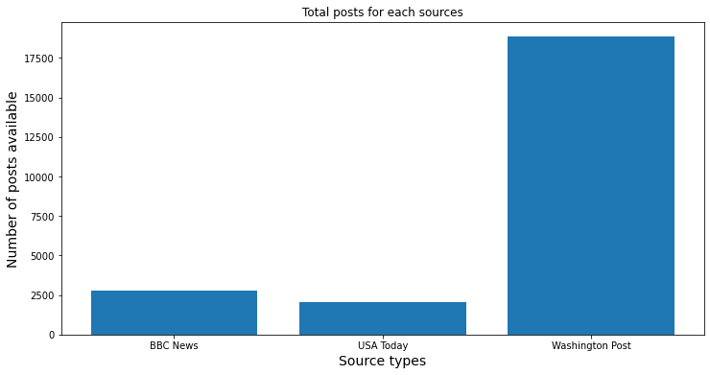
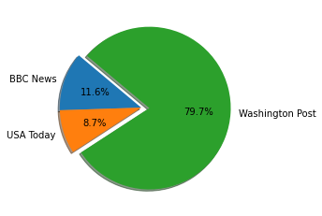
News Percantage

Slide 5
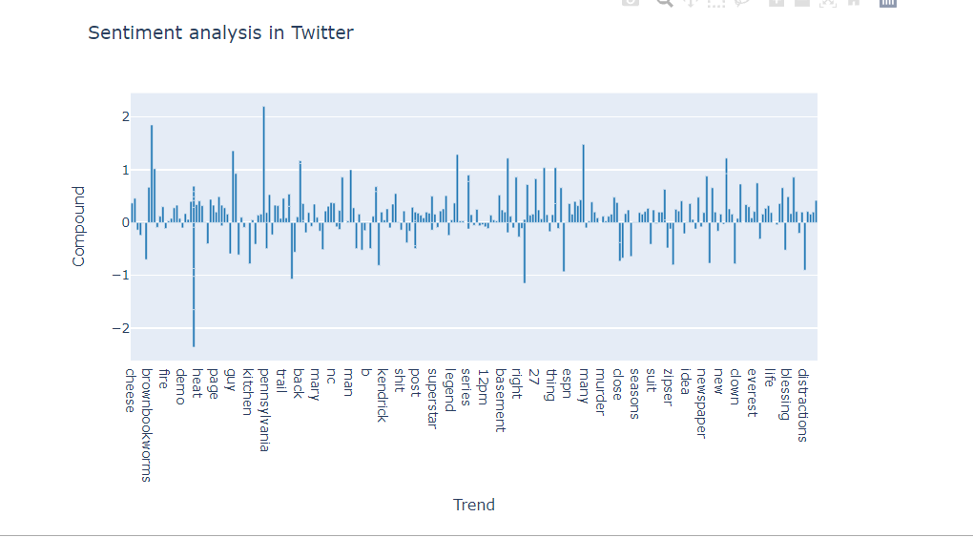
Sentiment Analysis with Twitter Dataset
We have only Positive and Negative scores on Dataset. So, I create new column as Cmpound which use for indicate positive or negative result.

Slide 6
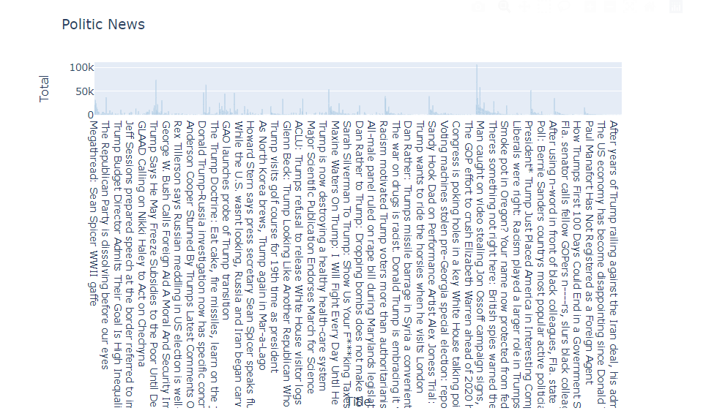
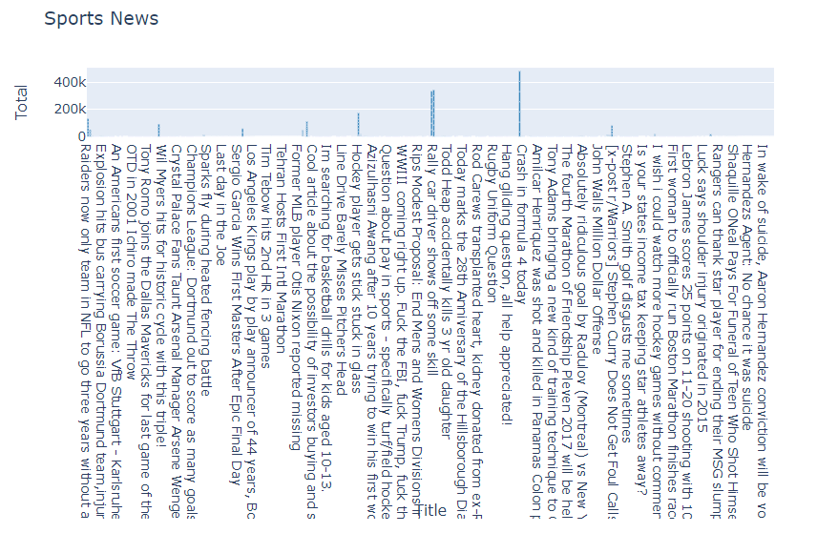
Used Plotly

Slide 7
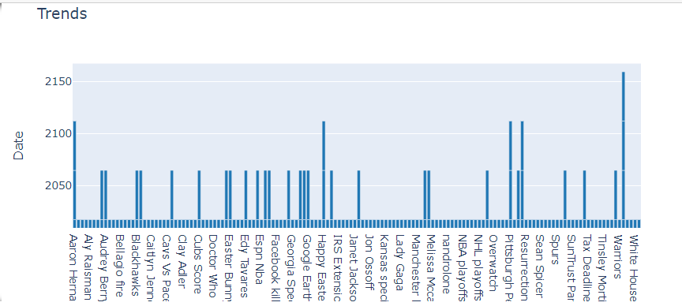
Trends

Slide 8
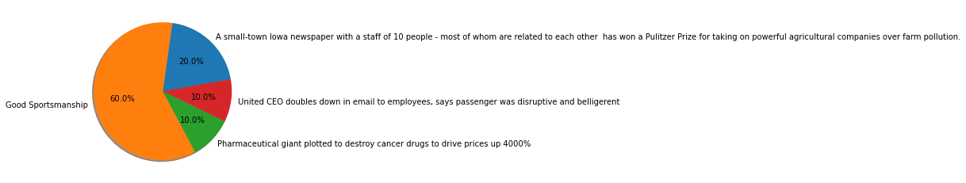
Best Scores Pie Chart

Slide 9
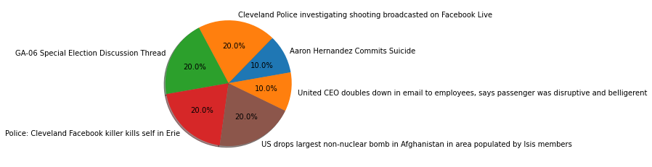
Best Comments Pie Chart

Slide 10

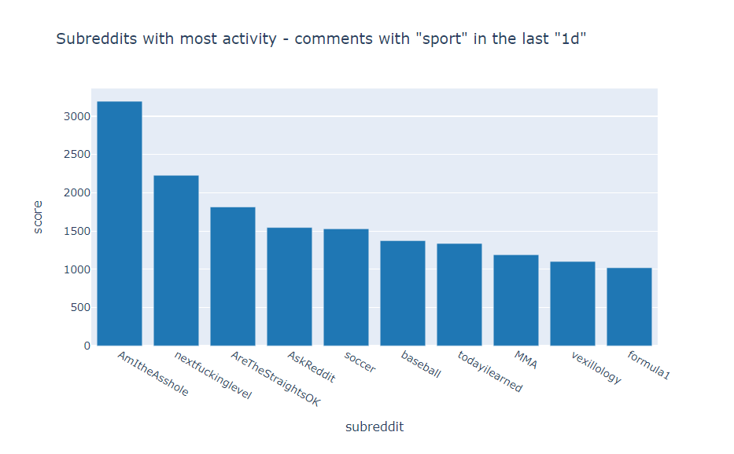

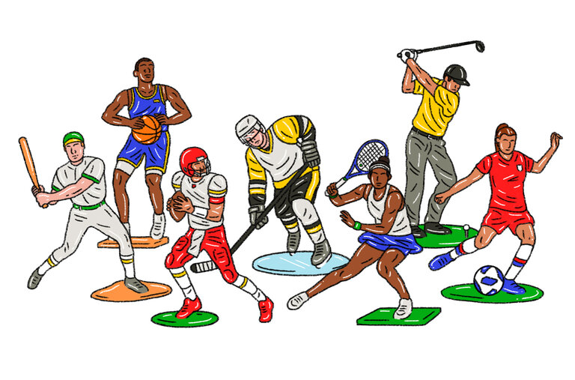
Reddit Api Analysis on Sport Query

Slide 11
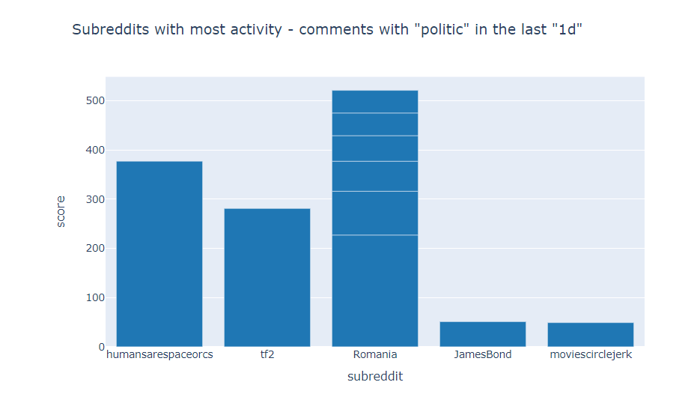

Reddit Api Analysis on Politic Query

Slide 12
THANK YOU

